Slide 1
Power cube ECC500 Upgrade

Slide 2
Introduction;
This document is meant to guide teams how to;
-Log onto the power cube rectifier system
-Do a software upgrade
-Integrate the power cube rectifier with the RMS system.

Slide 3
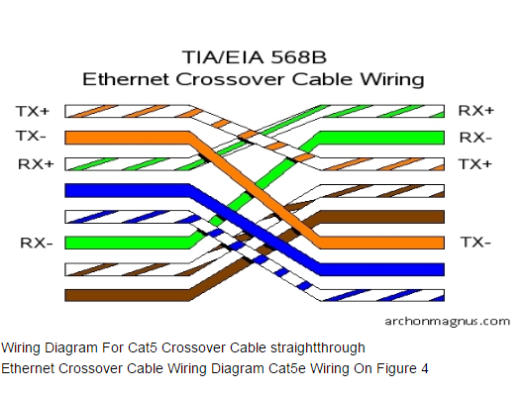
Logging onto the power cube system
There is no special software needed, login is also web based;
Tools to use;
-cross-over cable
-Laptop/ computer
-Web browser (IE, chrome or Firefox)
Cross-over cable;
Below is the wiring of the cross over cable

Slide 4
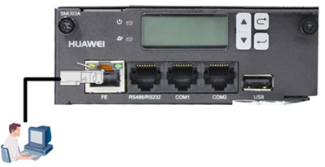
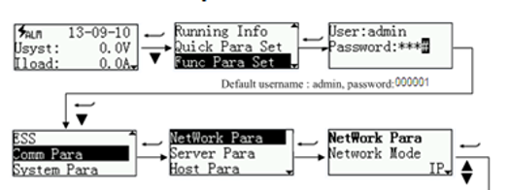
.
At both ends, RJ45 connectors are fixed.
One end is fixed to the FE port of the controller then another to the PC or laptop
Enabling communication;
Because we to use the IP to log onto the unit, the controller is then switch from GPRS (net Eco) to IP mode. Note password is 001. Below are the steps ;

Slide 5
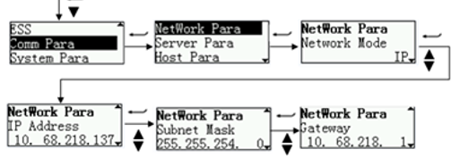
Setting IPs;
After enabling the IP mode, you will be able to see the active IP,subnet mask and the Gateway of the unit.
Currently, our units have different IPs, subnet masks and Gateways. For uniformity, I suggest that we set them all as below;
IP address:192.168.1.168
Subnet mask: 255.255.255.0
Gateway:192.168.1.1
IP under Internet protocol 4 is set as;
After this, the laptop static;
IP:192.168.1.169
Subnet mask:255.255.255.0
Gateway:192.168.1.1

Slide 6
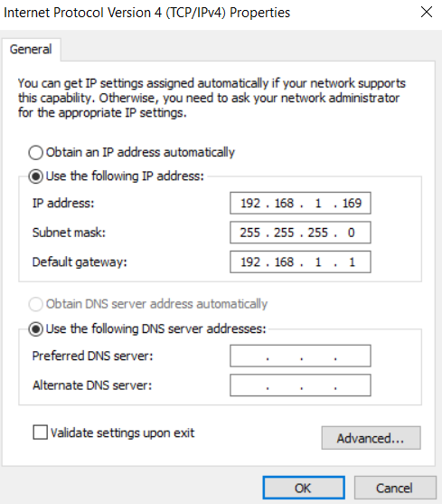
Steps for setting laptop static IP;
Open network and sharing centre, change adapter settings, eth com, properties, then change internet protocol 4 properties as below;

Slide 7
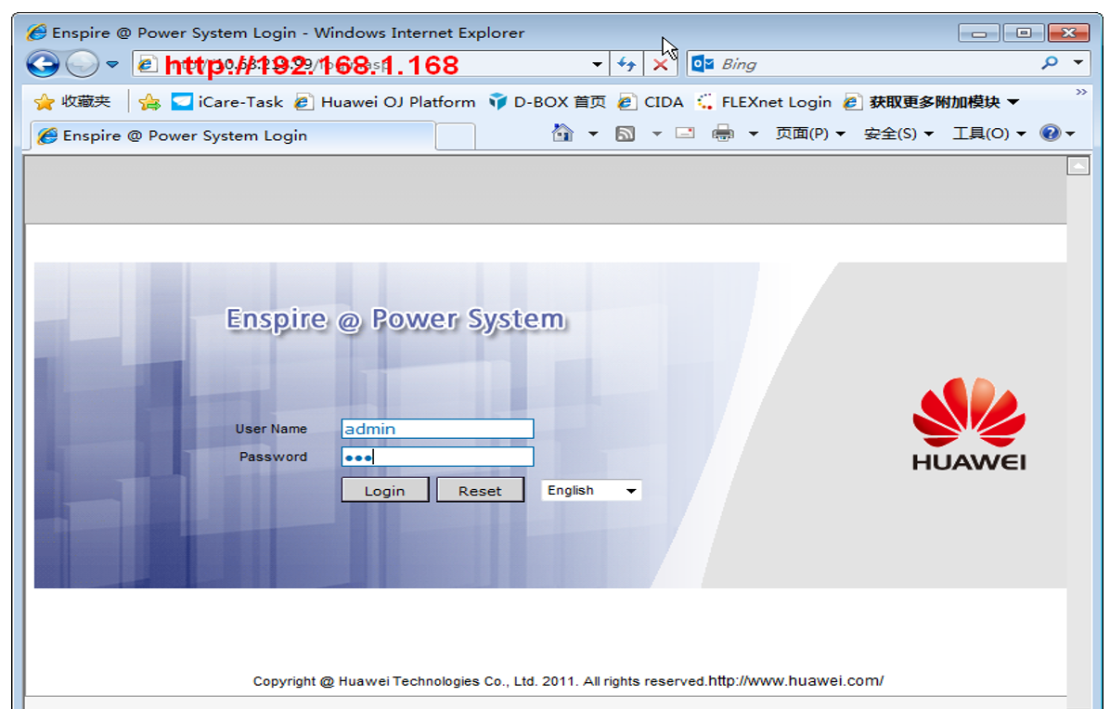
Logging onto the controller
Using the IE, we input 192.168.1.168. Below is displayed;
Note; the user name is; admin Password:001
Note

Slide 8
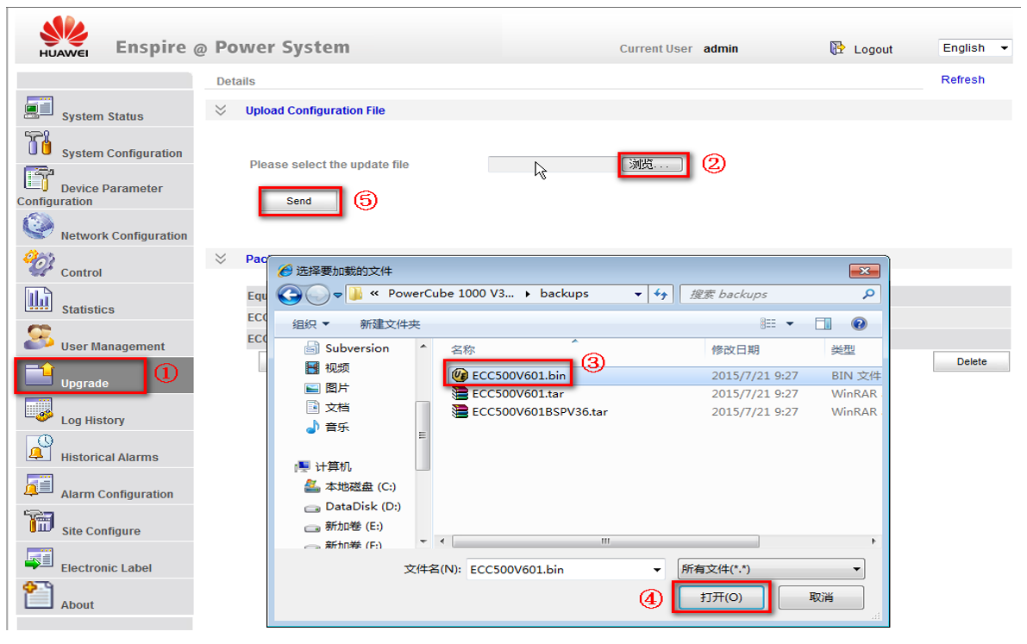
Software upgrade;
Below are the steps;
1-Select upgrade
2-Browse for the right SW.
3-Select file
4-Accept file (click ok)
5- select send to load the file.
Below is in Chinese but above interprets the steps

Slide 9
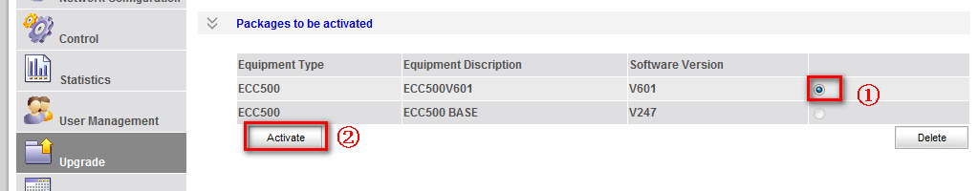
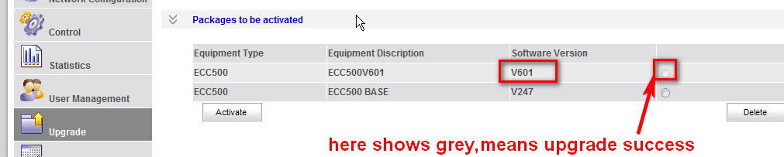
Software activation
After uploading the SW, it is then activated as below;
-choose the uploaded SW. Then press activate.
To show success;

Slide 10
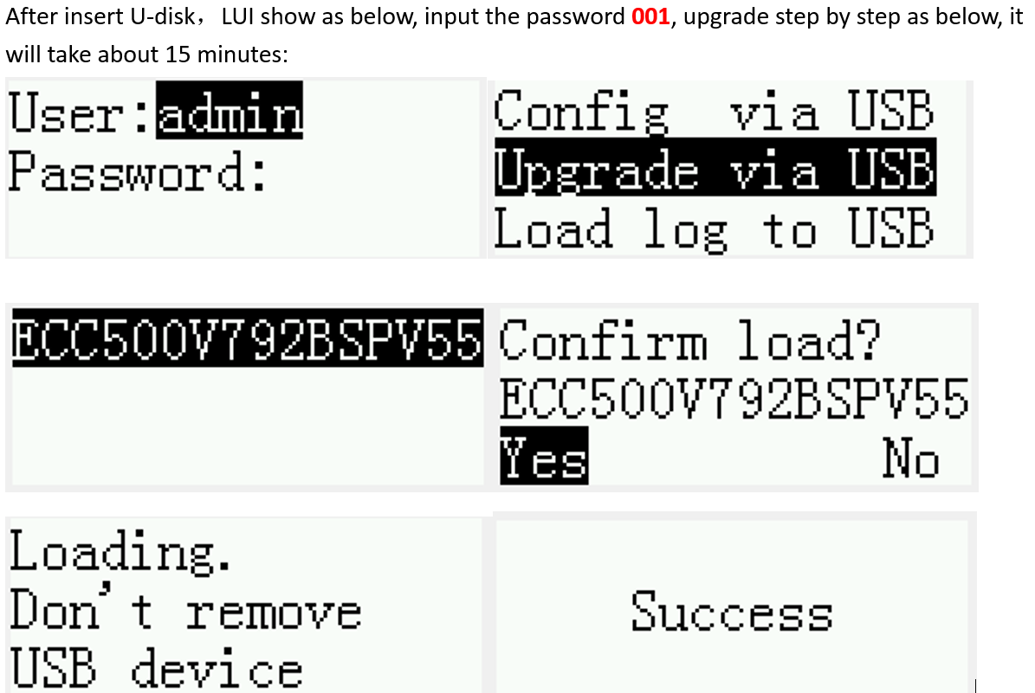
Manual upgrade;

Slide 11
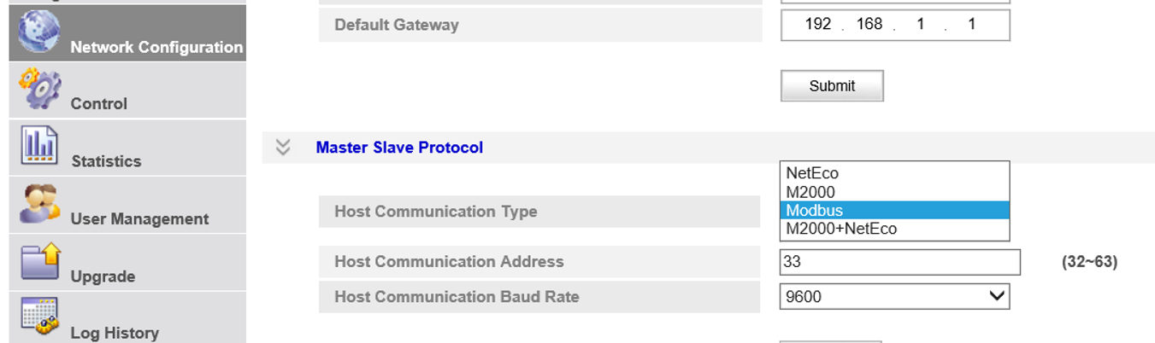
RMS communication settings
Our RMS provider accepted to set parameters as;
-Host Communication type: Modbus
-Host Address: 38
-Host communication Baud Rate; 19200
Steps;
Select Network configuration, then Master slave protocol. Below is just a demo, parameters must be set as above.

Slide 12
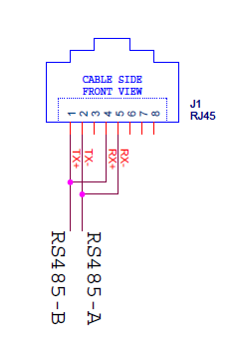
Cable connection;
The galooli system is linked to the rectifier system by a com cable. One end is RJ45 and another is open. On the open end, we select 4 cables.
Selected cable are 1,2,4 and 5. 1 is then paired with 4, 2 is paired with 5 as below.
These two points are then terminated to A(+ve) and B (-ve) of the RS485 burs of the galooli system.
The RJ45 end of the cable is then fixed to the RS485 port on the SMU controller.

Slide 13
Changes on the galooli end;
The galooli unit must be upgraded to a version fit to read power cube parameters.
Triton5 must be upgraded to version 1.35 or higher (latest is 1.36).
Where we have a K2, it must be of version 3.27.
On power centre, the rectifier type is then configured as power cube with ID 38 and baud rate 19200 as set on the controller.

Slide 14
THANK YOU

